Slide 1
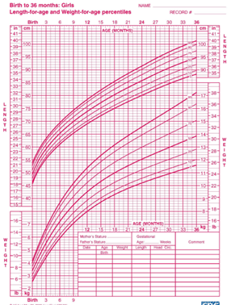
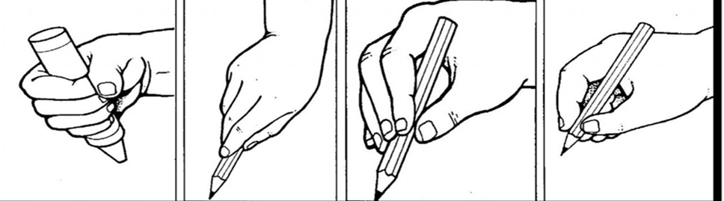
Physical Development is…
P I E S
3 Areas of Physical Development
1.
2.
3.
Other factors that can affect
Physical Development
What is a milestone?
The 4 main factors that affect
Physical Development
1.
2.
3.
4.
Sensory skills are…
Toys or activities to develop sensory skills…
What does each letter stand for?
Name:
Date:
How can a visit to the sea side encourage a child to improve their physical development?
Gross motors skills are…
Toys or activities to develop gross motor skills…
What is the chart below called and what is it used for?
Milestone | Age
Grabs toys using whole hand palmer grasp.
Runs avoiding obstacles, walks on tiptoes and can kick a ball.
Can sit unsupported for short periods of time.
Fine motors skills are…
Toys or activities to develop fine motor skills…
Identify the 4 grasps above.

Slide 2
Child Development Physical Development Milestones
Milestones in Physical Development
Read through the developmental milestones and fill in the gaps using the words below. Take your time to read each sentence carefully . Each word can only be used once.
STANDING | PRONE | UNZIP | 3 MONTH | ARM | UPSTAIRS | ROLL | PALMAR
GRASP | SHUFFLE | HEADS | THREAD | BALANCE | CRAWL | SCISSORS | TRIPOD | TOWER
ONE | FURNITURE | PINCER | FORK | TWO | HIDDEN | FOURS | WALK
KNIFE | LEG | CIRCLES | SITTING | 18 MONTH | SHOES | MOUTHS | TROUSERS
DRESS | DOWNSTAIRS | POINT | FACE | STEPS | FRONT | WOBBLES | SUPPORT
Learning to sit up– Birth to 6 months
New born babies can’t support their own _ _ _ _ _.
At 3 months a baby can be held in a _ _ _ _ _ _ _ position, but the head
_ _ _ _ _ _ _ around a bit.
A _ _ _ _ _ _ old baby can sit up if supported by a cushion.
At 9 months the baby doesn’t need any _ _ _ _ _ _ _ to sit up.
Learning to crawl– 3 to 12 months
At 3 months a baby can lie on its _ _ _ _ _ and push itself up on its arms. This is known as the ‘_ _ _ _ _ position’.
A 6 month old baby can push itself up on its arms and _ _ _ _ over.
A 9 month old can start to _ _ _ _ _, or pull itself around on its front.
A 12 month old can crawl, _ _ _ _ _ _ _ on its bum and walk on all
_ _ _ _ _.
At 15 months a baby can crawl _ _ _ _ _ _ _ _ forwards and
_ _ _ _ _ _ _ _ _ _ feet first.
Learning to stand and walk– 9 months to 3 years
A 9 month old baby can get on its knees and pull itself into a
_ _ _ _ _ _ _ _ position.
Between 9 and 12 months the baby can take a few _ _ _ _ _ while hanging onto _ _ _ _ _ _ _ _ _.
At 12 months a baby can _ _ _ _ with someone holding its hand.
A 15 month old can walk on its own but holds its arms out for
_ _ _ _ _ _ _.
At 18 months it walks without falling over and walks upstairs holding a handrail, _ _ _ feet on each step.
3 year olds can walk up and down stairs, _ _ _ foot to each step.
Fine motor skills for picking things up– Birth to 5 years
At birth babies have a _ _ _ _ _ reflex.
3 month old babies play with their hands and put them in their _ _ _ _ _ _.
At 6 months a baby can hold toys using the whole hand– a _ _ _ _ _ _ grasp.
A 9 month old holds things between thumb and forefingers– a _ _ _ _ _ _ grip.
12 months olds can _ _ _ _ _ at things. They drop and throw things and look for _ _ _ _ _ _ things,
A 15 month old can hold a crayon in its fist and build a _ _ _ _ _ of 2 bricks.
An _ _ _ _ _ _ _ old can make a tower of 4 0r 5 bricks.
By 2 years old the child can hold a crayon and make lines, _ _ _ _ _ _ _ and dots.
By 2½ years the child can _ _ _ _ _ _ large beads on a string and use a spoon.
A 3 year old can make a tower of 9 bricks, draw a _ _ _ _ and use child-safe
_ _ _ _ _ _ _ _.
A 4 year old holds a pencil properly (a _ _ _ _ _ _ grip) and can draw a person.
A 5 year old can use a _ _ _ _ _ and _ _ _ _.
Getting dressed and undressed– 12 months to 5 years
12 month olds stick out an _ _ _ or _ _ _ to help a parent or carer dress them.
An 18 month old can take off its _ _ _ _ _ and socks.
A 2 year old can put on shoes zip/_ _ _ _ _ a zipper.
3 year olds can take off and put on a coat and _ _ _ _ _ _ _ _.
5 year olds can _ _ _ _ _ and undress with very little help.

